Slide 1
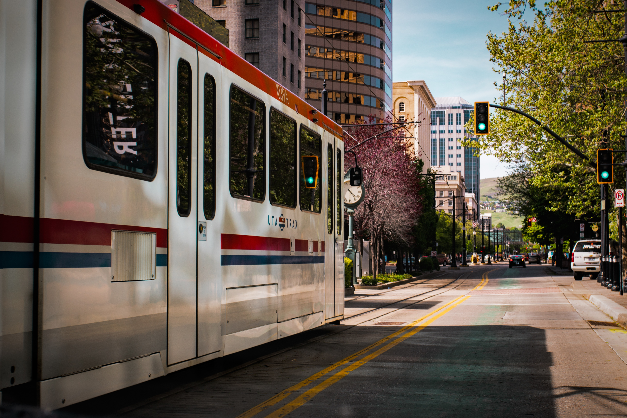
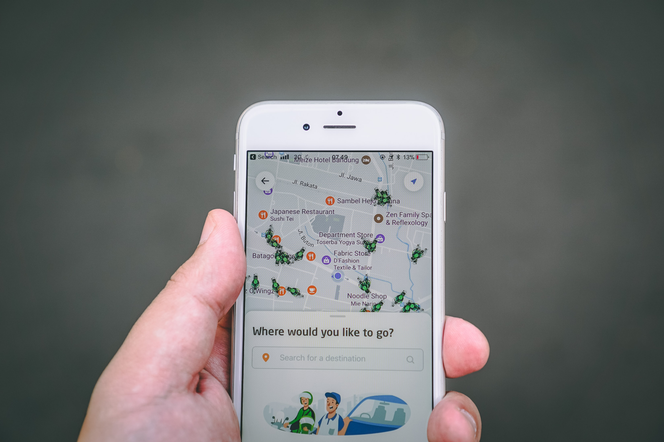
Utility-Based Accessibility to Community Resources: An Application of Location-Based Services Data
Gregory Macfarlane, PhD PE
Emma Stucki
Michael Copley

Slide 2
Outline
Access to community resources
Methodology
Results
Choice Models
Accessibility
Future Work

Slide 3
Access to Community Resources

Slide 4
Access to Community Resources
Lack of consistency in spatial impact findings
Parks access and physical / mental health
Nutrition access and physical health
Libraries and community membership / educational attainment
Frustrating inconsistency in spatial definitions
Percent of green space within 5 miles / any park within 10 minute walk, etc.
A “high-quality” grocery store within 1 mile

Slide 5
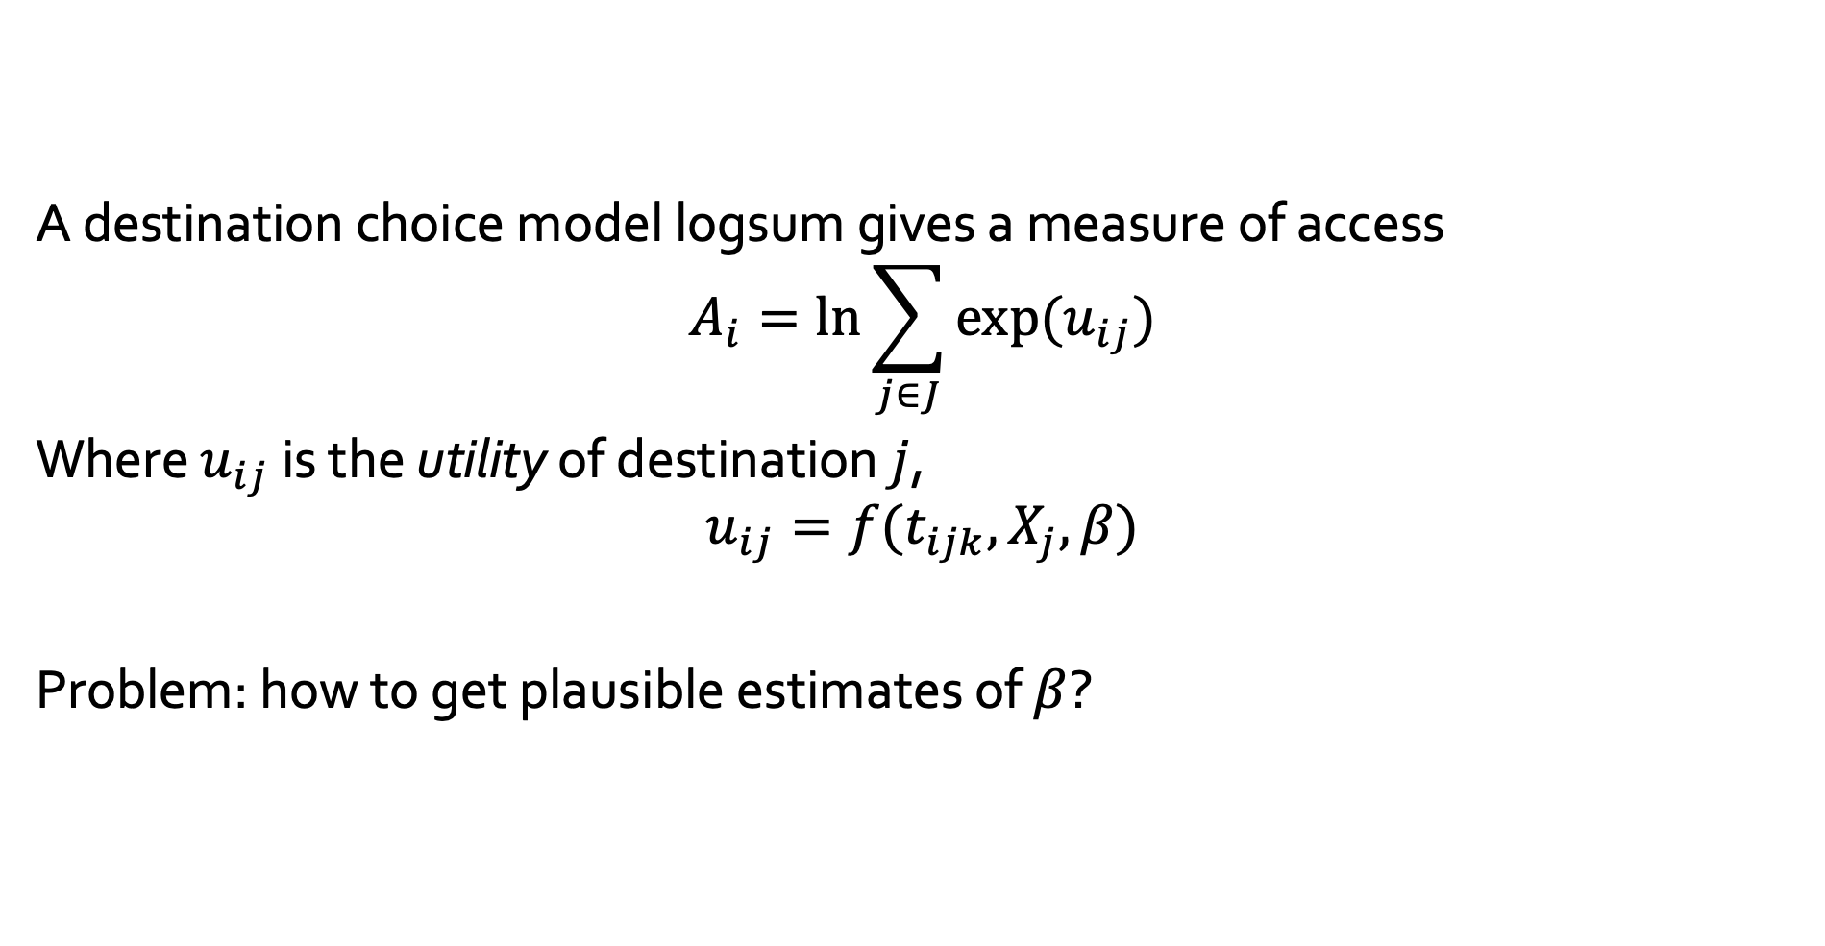
Utility-based Access
A destination choice model logsum gives a measure of access
$$A_{i}=\ln{\sum_{j∈J}{exp⁡(u_{ij}})}$$
Where $u_{ij}$ is the utility of destination $j$,
$$u_{ij}=f(t_{ijk}, X_{j}, β)$$
Problem: how to get plausible estimates of $β$?

Slide 6
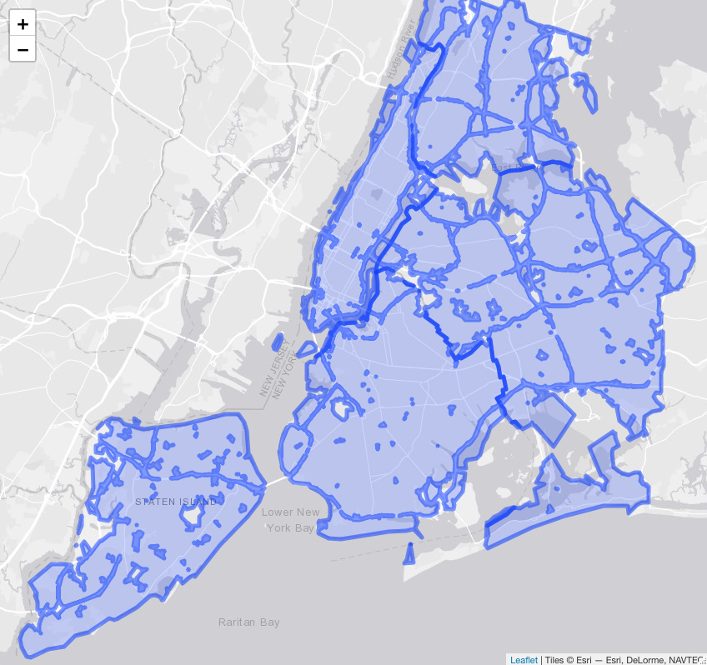
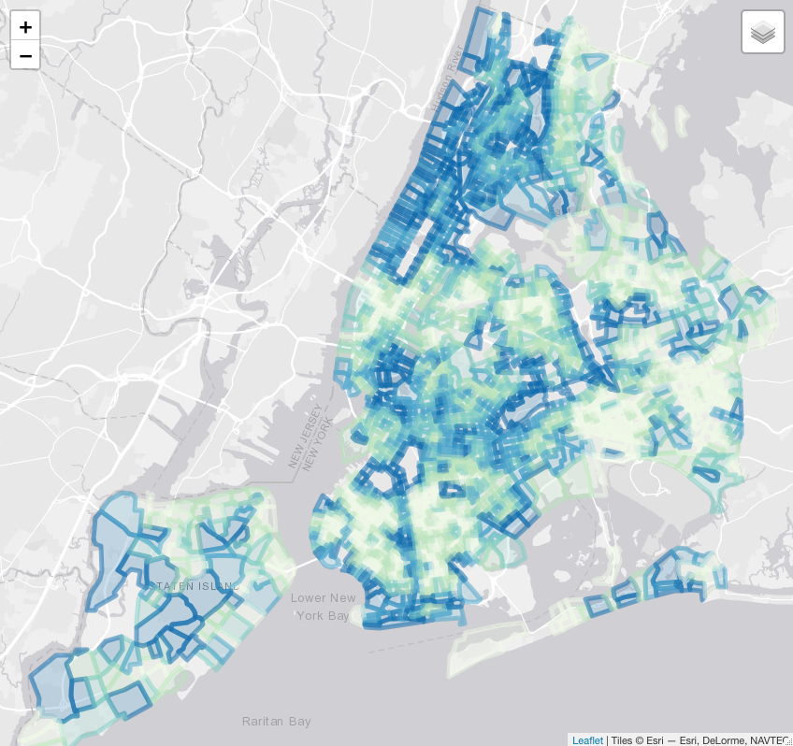
Buffers vs Utility-based Access
ParkScore 10-minute network walk to any park
Kinnel et al (2006) Park choice utility logsums

Slide 7
Methodology

Slide 8
Objective
Estimate initial destination choice models for multiple community resources
Construct a composite utility-base accessibility measure
Consider discrepancies between this and a travel-time buffer

Slide 9
Location-based Services Data
LBS Data
Resource polygons
Flow Shares
What percent of devices in a block group go to each resource?
Synthetic Choice Data
One observed choice
10 random choices
Number of devices in p'gon by home block group
10,000 draws

Slide 10
Resources in Utah County
Attributes from with OpenStreetMap
Parks: satellite and in-person validation
Grocery stores: NEMS-S data collection
Libraries: websites and in-person

Slide 11
Travel Times
From population-weighted block group centroid to resource (point or boundary)
Auto
Transit (including wait and transfer)
Walk
Mode choice logsum (multimodal impedance)

Slide 12
Results

Slide 15
Grocery 5-minute Buffer vs Logsum

Slide 16
Travel Time vs Logsum

Slide 17
Equity implications
All Households
Low-income Households
9,510
16,597
121,952
outside buffer
outside buffer
8,422
inside buffer
above mean logsum
below mean logsum
below mean logsum
inside buffer
above mean logsum
831
1,554
24,057
outside buffer
outside buffer
802
inside buffer
above mean logsum
below mean logsum
below mean logsum
inside buffer
above mean logsum

Slide 18
Limitations / Future Work
Ongoing discussion about accuracy / fidelity of LBS data
Refine choice models
Segment MCLS by income / ethnicity?
Synthetic population?
LOTS of stuff in NEMS-S
More detailed equity analysis
What happens in rural / more diverse areas?

